Slide 1
Control Structure
selection, iterations, branching, guarded statements

Slide 2
Selection
A control structure is a control statement and the collection of statements whose execution it controls.
A selection statement provides the means of choosing between two or more execution paths in a program
Selection statements fall into two general categories: two-way and n-way, or multiple selection.

Slide 3
Two-Way Selection Statements
The general form of a two-way selector is as follows:
if control_expression
then clause
else clause
Example of C language
If(<condition>){
statement;
}
Else{
statement;
}

Slide 4
Multiple-Selection Statements
The multiple-selection statement allows the selection of one of any number of statements or statement groups.
Example switch statement

Slide 5
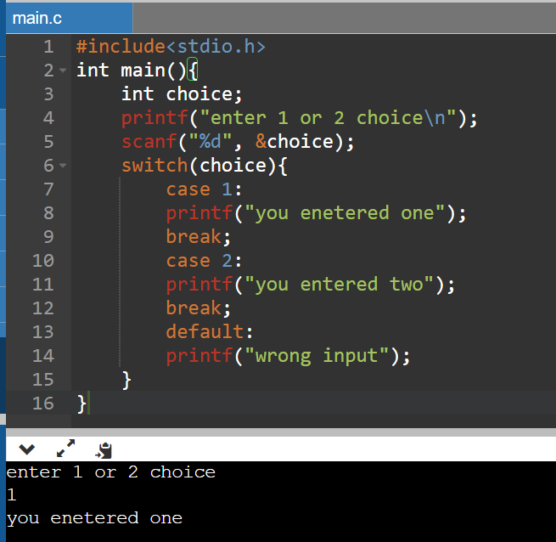
Example of switch statement

Slide 6
Iterative Statements
An iterative statement is one that causes a statement or collection of statements to be executed zero, one, or more times. An iterative statement is often called a loop.

Slide 7
Counter-Controlled Loops
A counting iterative control statement has a variable, called the loop variable, in which the count value is maintained. It also includes some means of specifying the initial and terminal values of the loop variable, and the difference between sequential loop variable values, often called the stepsize. The initial, terminal, and stepsize specifications of a loop are called the loop parameters.
Example for, while, dowhile loop

Slide 8
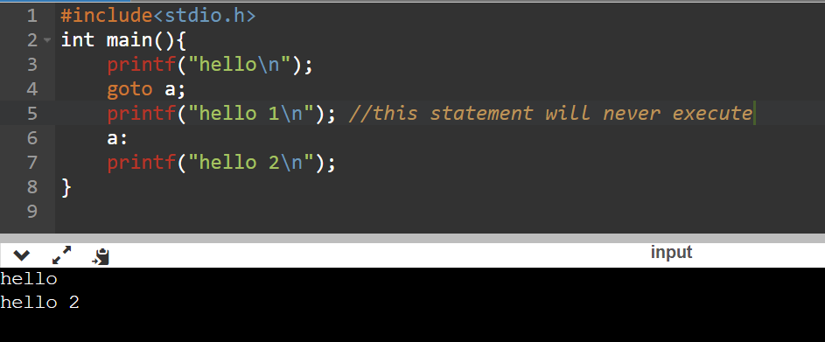
Unconditional Branching
An unconditional branch statement transfers execution control to a specified location in the program.
Example goto statement

